Slide 1


Department of Artificial Intelligence and Data Science
SmartSpace: Transforming Retail Shelves with Market Basket Analysis
Supervisor
Dr.V.Saravanakumar
SAI NARAYAN R (221801042)
SANJAY B (221801045)

Slide 2
Problem Statement and Motivation
A grocery chain wants to optimize shelf space utilization by analyzing sales data and customer shopping patterns. They aim to improve product placement and inventory management.
□ By organizing shelves better, stores can sell more of what customers want, making more money.
□ Using sales info and shopper behavior helps stores decide which products to stock and where to put them.
□ Organizing shelves efficiently saves time and effort in restocking and managing inventory.

Slide 3
Objectives
The objective is to optimize shelf space utilization in the grocery chain by leveraging sales data and customer shopping patterns. This will involve analyzing product performance and consumer behavior to enhance product placement strategies, ensuring that high-demand items are easily accessible and well-stocked. The goal is to maximize sales, improve inventory management, and increase customer satisfaction.

Slide 4
Abstract
Optimizing shelf space utilization in a grocery chain requires a strategic approach grounded in the analysis of sales data and customer shopping patterns. aims to enhance product placement by leveraging insights from product performance and consumer personas. the goal is to improve the accessibility and availability of high-demand items, increase sales, reduce stockouts, and ensure efficient inventory turnover. The outcomes of this analysis will offer actionable strategies for more effective analysis and inventory practices within the grocery chain.

Slide 5
Introduction and Overview of the Project
Customer Behavior Analysis for Efficient Shelf Space Management is crucial for optimizing retail environments.
Current methods often suffer from inaccurate data and inefficient analysis tools.
Implement a system with advanced analytics and automated data collection and enable adjustments based on real-time customer behavior, maximizing sales potential.

Slide 6
Literature Survey
Grocery shelf optimization has been extensively studied to enhance profitability and customer satisfaction. Huang et al. [1] and Tsai and Huang [2] utilized data mining techniques to optimize shelf space by analyzing customer behavior and movement patterns. Heikal and Gandhi [3] applied market basket analysis to develop strategies for diverse consumer needs, while Agarwal et al. [4] and Mulkan [5] leveraged the Apriori algorithm to improve store layouts and product placement. David [6] further demonstrated its use in enhancing in-store experiences through shopping pattern analysis.

Slide 7
S.No | Author Name | Paper Title | Description | Journal | Volume/ Year
1 | Sheng-Hsiang Huang, Chieh-Yuan Tsai, Chih-Chung Lo | A Multi-Data Mining Approach for Shelf Space Optimization Considering Customer Behaviour | The paper focuses on utility mining to enhance product profitability and solve the product-to-shelf assignment problem using consumer behavior data. | 11th International Conference on e-Business (ICE-B-2014) | 2014
2 | Chieh-Yuan Tsaiab, Sheng-Hsiang Huang | A data mining approach to optimize shelf space allocation in considering customer purchase | The paper proposes a three-stage data mining method to optimize retail shelf space by analyzing customer purchase and movement patterns. | Expert Systems with Applications (2013) | 2015
3 | Jerry Heikal, Ayu Gandhi | Enhancing Retail Supermarket Financial Performance Through Market Basket Analytics | This paper explores the application of Market Basket Analysis to identify product strategies to diverse consumer personas | Business and Retail Management Research (2021) | 2024

Slide 8
Literature Survey
S.No | Author Name | Paper Title | Description | Journal | Volume/ Year
4 | Pragya Agarwal, Madan Lal Yadav, Nupur Anand | Study on Apriori Algorithm and its Application in Grocery Store | The paper discusses the Apriori algorithm and examines improvements to enhance grocery store data analysis. | International Journal of Computer Applications Volume 74, No.14, July 2013 | 2013
5 | Balya Ibnu Mulkan | An approach to improve layout store and product placement using Apriori algorithm | The paper discusses improving store layout and product placement using a combination of the Apriori algorithm and Profited Sequential Pattern | International Program, Department of Industrial Engineering, Universitas Islam Indonesia, in 2018. | 2018
6 | Ioana David | Improving the Customers’ In-Store Experience using Apriori Algorithm | The paper discusses About improving the customers experience through apriori algorithm and keeps monitoring on the shopping patterns | Department of Economic Informatics and Cybernetics Database Systems Journal, vol. X/2019 | 2019

Slide 9
Existing System
Currently, stores rely on employees observing customer behavior and making decisions based on their observations.
Use of traditional methods like paper records or basic spreadsheets for tracking sales and inventory.
Inability to quickly adjust product placement or inventory levels in response to changing customer preferences or market conditions.

Slide 10
Drawback of Existing System
Depending on people to track and restock shelves leads to
mistakes and slow updates.
Products are placed in the same spots without using sales data
or how customers shop.
Not using shelf space in the best way to sell more products.
Difficulty in quickly adjusting product placement or inventory levels in response to changing customer preferences or market conditions.

Slide 11
Proposed System
The proposed system uses the Apriori algorithm to optimize product placement in a grocery chain. By analyzing sales and customer behavior data, it identifies which products are frequently bought together,This approach ensures better use of shelf space and boosts sales by positioning high-demand items where they are most accessible. The system also reduces errors and ensuring popular products are always available. Continuous monitoring allows the system to adapt to changing shopping patterns, making shelf space more efficient and responsive to customer needs.

Slide 12
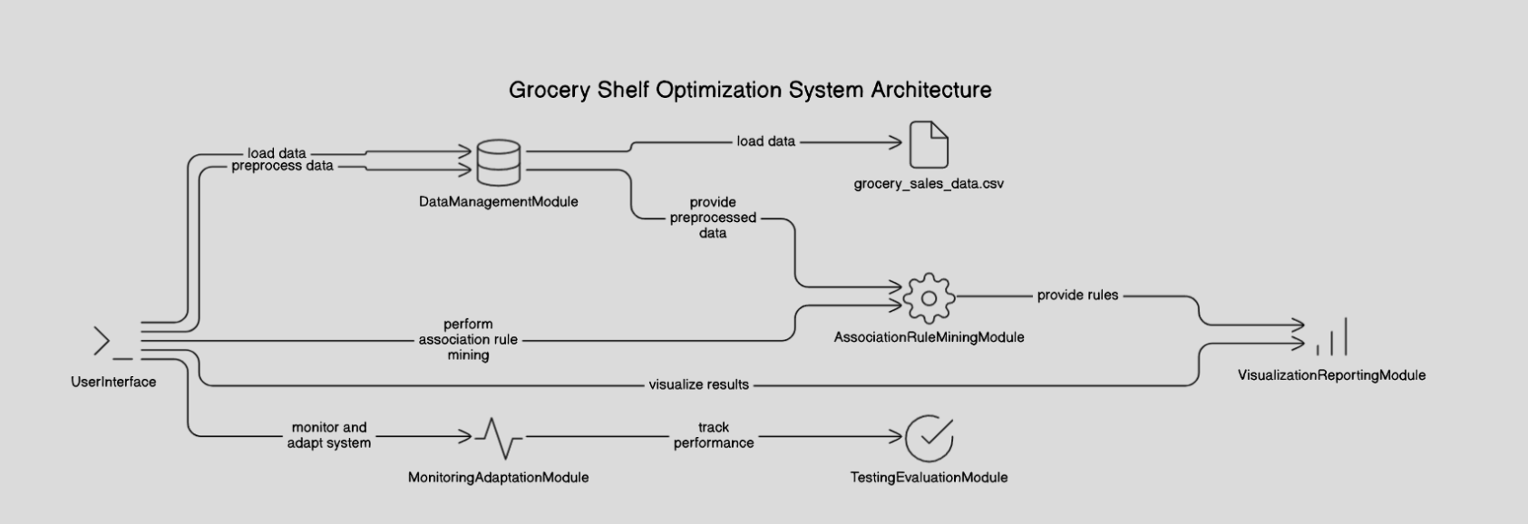
System Architecture

Slide 13
List of modules
Data Management Module: Collect, integrate, clean, and preprocess sales, customer, and inventory data.
Association Rule Mining Module : Use the Apriori algorithm to identify items and optimize product placement and restocking.
Visualization and Reporting Module: Create visualizations and reports for product placement and inventory insights.
Monitoring and Adaptation Module: Continuously adjust recommendations based on real-time data and changing patterns.
User Interface: Develop an interface, integrate with existing systems, and deploy the solution.
Testing and Evaluation Module: Test performance, gather feedback, and refine the system as needed.

Slide 14
Module 1 : Data Management Module
Step 1: Collect customer behavior, sales, and inventory data
Gather transaction history, preferences, in-store movement, and demographics. Collect sales performance and stock levels across products, promotions, and locations.
Step 2: Clean and preprocess the data
Remove duplicates, handle missing data, and normalize formats across datasets. Ensure data quality by addressing inconsistencies in sources such as sales, inventory, and customer records.
Step 3: Integrate datasets
Merge customer behavior, sales, and inventory data into a unified system. This will allow cross-analysis between customer behavior patterns and stock movement.
Step 4: Segment customers and products
Group customers based on buying patterns, demographics, and preferences. Similarly, categorize products by sales frequency, seasonality, and profitability.

Slide 15
Module 1 : Data Management Module
Step 5: Analyze demand and customer behavior
Use statistical or machine learning techniques to analyze demand trends. Predict future customer buying behavior and product demand based on historical patterns.
Step 6: Forecast inventory needs
Leverage demand analysis to predict future inventory requirements. Ensure optimal stock levels by aligning reordering with forecasted sales and demand.
Step 7: Optimize shelf space allocation
Allocate shelf space based on sales performance, demand trends, and customer preferences. Prioritize high-demand or high-margin products in prime locations.
Step 8: Test, iterate, and monitor
Run in-store experiments like A/B testing to validate layout strategies. Continuously monitor real-time sales and inventory data to adjust and refine the layout.

Slide 16
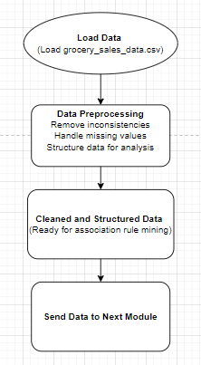
Data Flow Diagram
Final Review
Department of Artificial Intelligence and Data Science

Slide 17
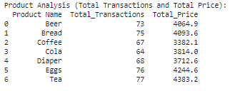
Output Screenshot
Department of Artificial Intelligence and Data Science
Final Review

Slide 18
Module 2 : Associate Rule Mining Module
Step 1: Input
Gather the transaction dataset containing customer purchases.
Step 2: Set Parameters
Define the minimum support and confidence thresholds to filter results.
Step 3: Generate Frequent Item sets (1-itemsets)
Count the occurrences of each item to create a list of frequent 1-itemsets based on the support threshold.
Step 4: Generate Candidate Item sets
Use frequent 1-itemsets to create candidate 2-itemsets by combining items from the frequent itemset list. For each combination of frequent items, generate pairs (or larger sets) of items to form candidate item sets.

Slide 19
Module 2 : Associate Rule Mining Module
Step 5: Count Support for Candidate Item sets
Scan the transaction dataset to count support for each candidate itemset and retain those meeting the support threshold.
Step 6 : Repeat for Higher-Order Item sets
Continue generating and counting support for candidate k-item sets until no more frequent item sets can be formed.
Step 7 : Generate Association Rules
For each frequent itemset, generate all possible rules and calculate their confidence
Step 8 : Output
Compile a list of strong association rules that meet the confidence threshold, including their support and confidence values.

Slide 20
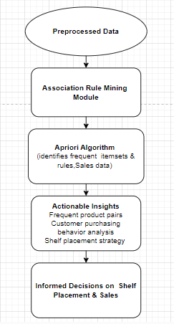
Data Flow Diagram
Department of Artificial Intelligence and Data Science
Final Review

Slide 21
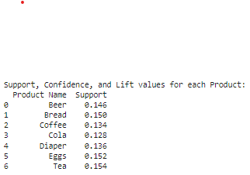
Output Screenshot
Department of Artificial Intelligence and Data Science
Final Review

Slide 22
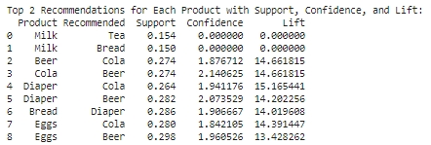
Output Screenshot
Department of Artificial Intelligence and Data Science
Final Review

Slide 23
Module 3 : Visualization Module
Step 1: Input
Collect sales data (e.g., product sales, revenue) and customer shopping patterns (e.g., most bought items, time spent in sections).
Step 2: Set Visualization Objectives
Define the key goals, such as identifying top-selling products, underperforming items, and customer movement patterns to optimize product placement and shelf space.
Step 3: Choose Visualization Types
Select appropriate visualizations like bar charts for top-selling products, line charts for sales trends.
Step 4: Prepare Data for Visualization
Group products by categories, sales performance, and customer movement frequency. Summarize the data by sales volume, profit margin, and customer flow.
Department of Artificial Intelligence and Data Science
Final Review

Slide 24
Module 3 : Visualization Module
Step 5: Create Initial Visualization
Plot sales trends by day, week, or month using line graphs. Use bar charts to display top-selling products and heatmaps to visualize customer movement patterns in-store.
Step 6 : Customize Visualizations
Add clear labels for products, sales figures, and sections. Use different colors to highlight high-selling and low-selling items, adjusting layouts for easier interpretation.
Step 7 : Validate Insights
Check if high-performing items are optimally placed. Identify products with low visibility or poor sales that might need re-positioning.
Step 8 : Output
Finalize and export visualizations (e.g., PDFs for reports or interactive dashboards) to present to stakeholders, offering insights into optimizing shelf space and product placement.
Department of Artificial Intelligence and Data Science
Final Review

Slide 25
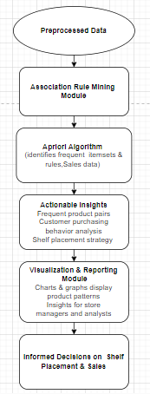
Data Flow Diagram
Department of Artificial Intelligence and Data Science
Final Review

Slide 26
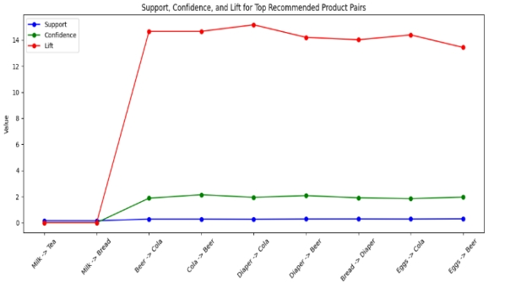
Output Screenshot
Final Review
Department of Artificial Intelligence and Data Science

Slide 27
Module 4 : Monitoring and Adaptaion Module
Step 1: Input
Continuously collect updated sales data, inventory levels, and customer shopping patterns in real-time (e.g., daily sales, changes in customer behavior).
Step 2: Set Monitoring Objectives
Define what needs to be tracked over time, such as product stockouts, changes in top-selling products, customer traffic flow, and seasonal shifts in buying patterns.
Step 3: Set up Automated Alerts and KPIs
Establish KPIs (e.g., stock turnover rate, sales growth, foot traffic) and set up automated alerts for low stock, high-performing products, or significant drops in sales.
Step 4: Develop Real-Time Dashboards
Create real-time dashboards to monitor key metrics, such as sales performance, inventory status, and customer traffic, using visualizations like time-series graphs and gauges.
Department of Artificial Intelligence and Data Science
Final Review

Slide 28
Module 4 : Monitoring and Adaptation Module
Step 5: Identify Trends and Anomalies
Regularly review data to identify trends, patterns, and outliers. Look for seasonal shifts in demand, changes in shopping behavior, or sudden drops in performance.
Step 6 : Adapt Shelf Space and Inventory in Real-Time
Reallocate shelf space or reposition products based on real-time data (e.g., moving high-demand items to prime locations, restocking fast-selling products).
Step 7 : Test and Implement Adjustments
Test different product placements or marketing strategies and monitor their effects on sales and customer behavior. Implement successful changes chain-wide.
Step 8 : Feedback Loop for Continuous Improvement
Hold regular performance reviews, using the monitoring data to make further refinements in product placement and inventory management.
Department of Artificial Intelligence and Data Science

Slide 29
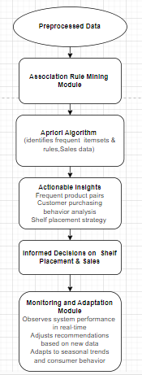
Data Flow Diagram
Department of Artificial Intelligence and Data Science

Slide 30
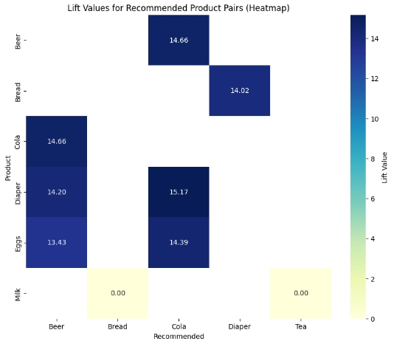
Output Screenshot
Department of Artificial Intelligence and Data Science

Slide 31
Support Formula
Definition: In the Apriori algorithm, support measures how often an item or itemset appears in the dataset as a percentage of all transactions.
Formula:
Purpose
Support helps identify which itemsets are common enough to consider for rule generation. A higher support value means the itemset appears frequently in the transactions. It helps identify frequent itemsets by filtering out items that appear too rarely to be useful.
Department of Artificial Intelligence and Data Science

Slide 32
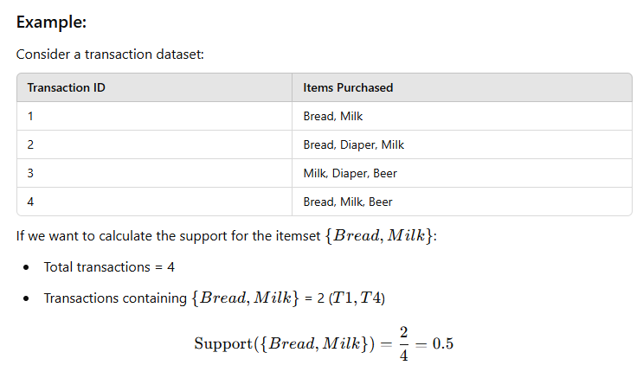
Example for Support
Department of Artificial Intelligence and Data Science

Slide 33

Confidence Formula
Definition: In the Apriori algorithm, confidence measures how often items in a rule are bought together. It is the likelihood that a transaction containing one itemset (the antecedent) also contains another itemset
Formula:
Purpose
Confidence evaluates the strength of an association rule, helping to find strong relationships between items. High confidence means that the rule is likely to be valid.
Department of Artificial Intelligence and Data Science

Slide 34
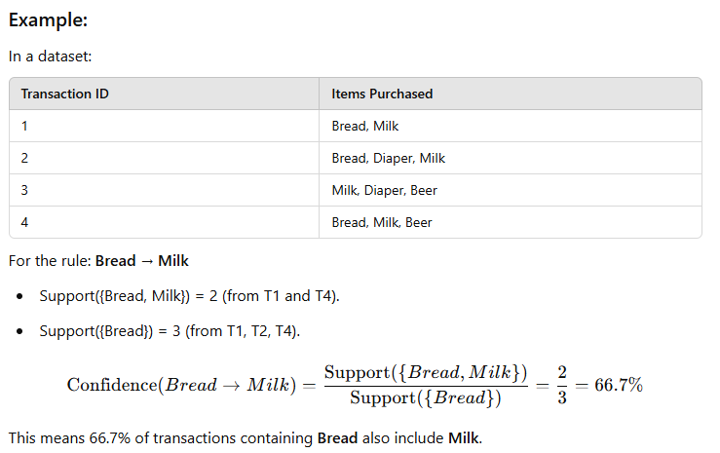
Example for Confidence
Department of Artificial Intelligence and Data Science

Slide 35

Lift Formula
Definition: In the Apriori algorithm, lift measures the strength of an association rule compared to the expected co-occurrence of items if they were independent. It tells us how much more likely the items in the rule are to appear together than by random chance..
Formula:
Purpose
Lift indicates whether the presence of item X increases the likelihood of purchasing item Y.
Department of Artificial Intelligence and Data Science

Slide 36
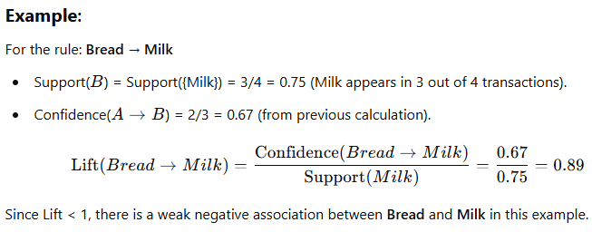
Example for Lift
Department of Artificial Intelligence and Data Science

Slide 37
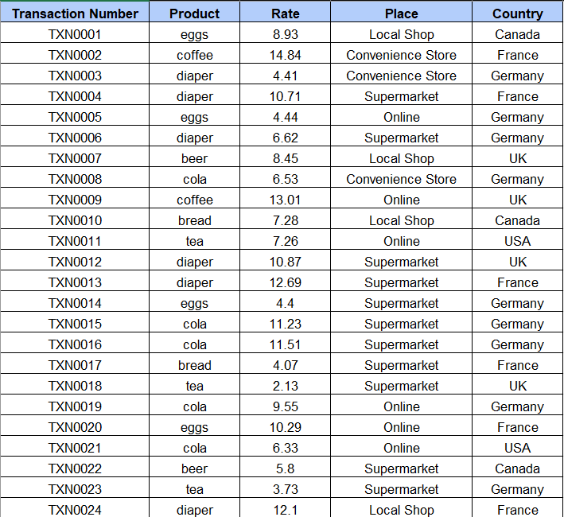
Formula – Excel Sheet
Department of Artificial Intelligence and Data Science

Slide 38
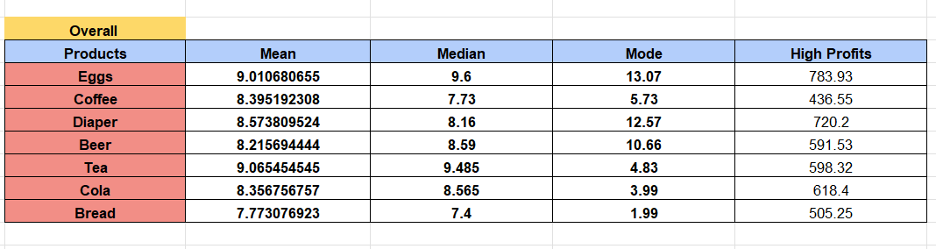
Formula – Excel Sheet
Department of Artificial Intelligence and Data Science

Slide 39
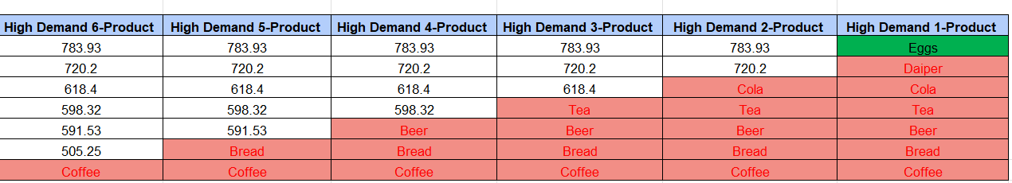
Formula – Excel Sheet
Department of Artificial Intelligence and Data Science

Slide 40
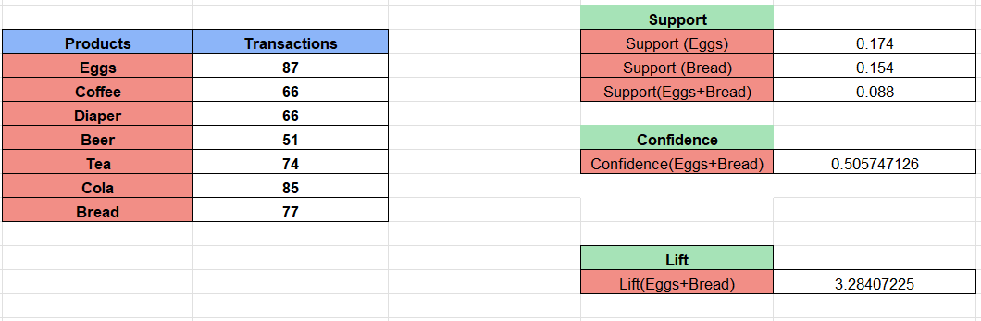
Formula – Excel Sheet
Department of Artificial Intelligence and Data Science

Slide 41
Conclusion
By analyzing sales data and customer shopping patterns, the grocery chain can optimize shelf space utilization to enhance product placement and improve inventory management. Strategic positioning of high-demand items can increase visibility and drive sales, while efficient inventory management minimizes stockouts and reduces overstock. These actions lead to better customer satisfaction, reduced waste, and increased profitability, providing a competitive advantage in the retail market.
Department of Artificial Intelligence and Data Science

Slide 42
References
S. P. Parikh, S. S. Dedhia, and K. V. Padole, "Market Basket Analysis Using Association Rule Mining," International Journal of Computer Science and Information Technologies, vol. 6, no. 2, pp. 1958-1961, 2015.
V. Venkatesan and K. V. N. Sunitha, "Market Basket Analysis for a Supermarket based on Frequent Itemset Mining," in Proceedings of the International Conference on Data Science and Engineering (ICDSE), Cochin, India, 2012, pp. 14-17.
S.-H. Huang, C.-Y. Tsai, and C.-C. Lo, "A Multi-Data Mining Approach for Shelf Space Optimization Considering Customer Behaviour," International Conference on Data Science and Advanced Analytics (DSAA), 2014, pp. 1-8.
Thomas, J. A., & George, S. "Application of Apriori Algorithm in Supermarket Shelf Space Optimization." Proc. IEEE International Conference on Intelligent Computing and Control (I2C2), 2017.

Slide 43
Thank You

